Slide 1


Slide 2

Agenda
Meet the Teacher
• Class Expectations
Class Schedule
Grading / Wednesday Folders
National Honor Society
Teacher Websites
Parent Conferences
Field Trips/Volunteers
Dress Code
5th Grade Promotion

Slide 3

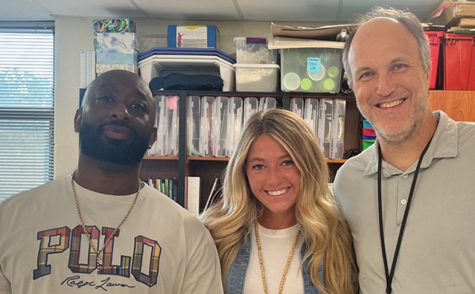
Mr. James Wardlow ELA
Ms. Taylor Aarron Science and Social Studies
Mr. Greg Dillender Math
Mr. James Wardlow WardlowJ@scsk12.org
Ms. Taylor Aarron: AaronT@scsk12.org
Mr. Greg Dillender: Dillendergt@scsk12.org

Slide 4

Positive Attitude
Character Pledge
Fabulous Four
• A- act safely
• B- be responsible and respectful
• C- care for yourself, others and the environment
• D- do your best at all times

Slide 5
Homework
Expectations
ELA: Wednesday
Science/SS: Monday
Math: Every weeknight
If classwork isn't completed,
it may be assigned for homework.

Slide 6

Grading EXPECTATIONS
* For every day you are absent, you will receive a day to make
up assignments.
Example: absent 2 days, assignments will be due two days after the absence.
* Late work, excluding absences, will be marked with zeros until it is turned in.
10 % will be deducted per day until the assignment is turned in.

Slide 7
Grading Scale
A- 90-100 Test grades count 45%
B- 80-89 Classwork count 40 %
C- 70-79 Homework –5 %
D- 60-69 Projects—5%
F- Below 60 Participation 5%

Slide 8

Schedule
8:15-8:25 HR
8:30-9:20 ENCORE
9:20-10:50 Block 1
10:50-12:30 Block 2
12:30-1:00 LUNCH
1:00-2:30 Block 3
2:30--3:10-BOOST

Slide 9
“Wednesday Folders”
Wednesday folders will go home weekly. You may also log in to PowerSchool often to check your child’s grades.

Slide 10
Weekly Conduct
E = 0 checks
G =1-2 checks
S= 3-6 checks
N =7-8 checks (or serious issue)
U= 9+ checks (or serious issue)

Slide 11
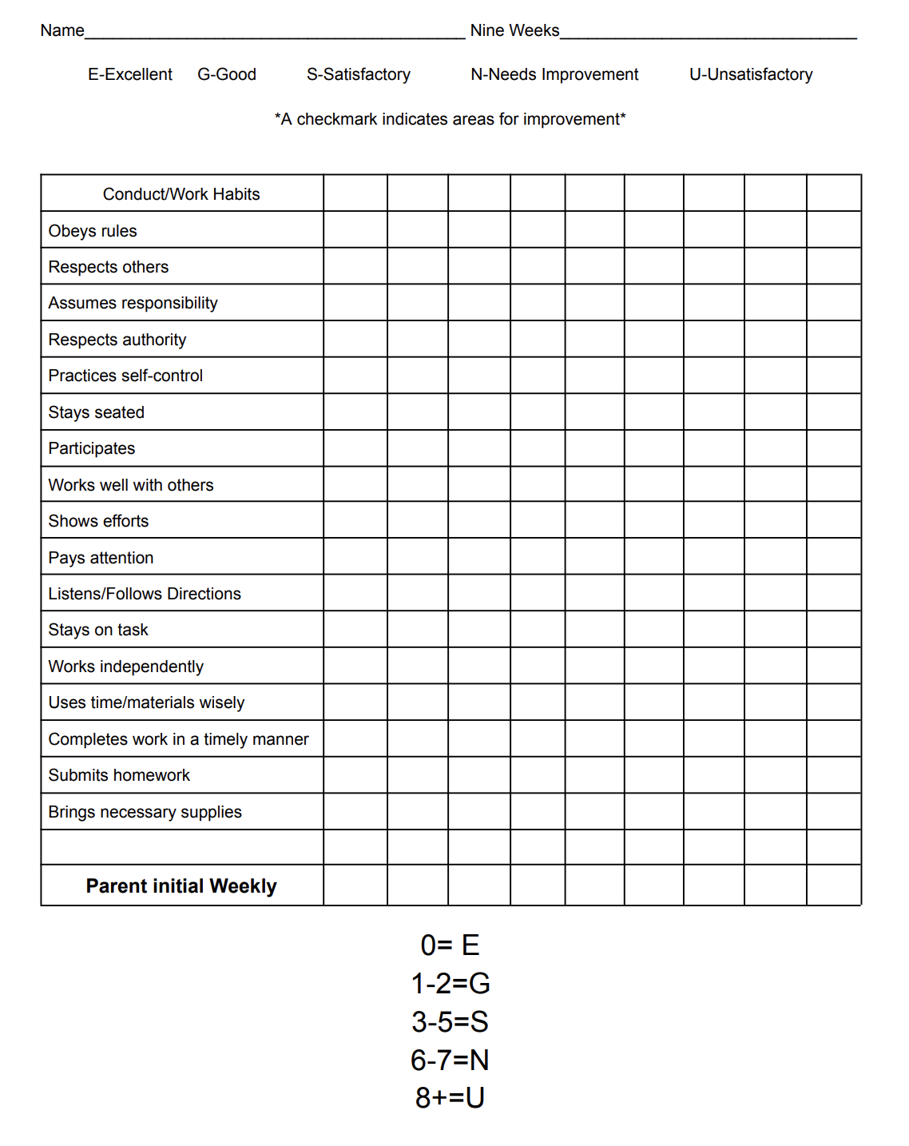
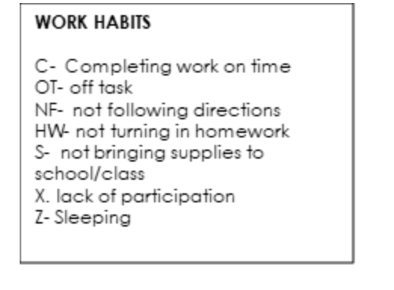
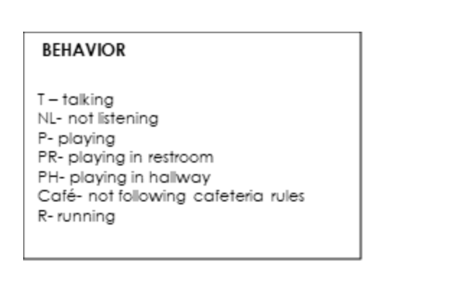
“Wednesday Folders”
Conduct /Behavior

Slide 12

All parents need to acknowledge that they have reviewed the Richland Student Handbook

Slide 13
Boost
This is a 45 minute period during which your child will receive differentiated instruction.
It is designed to create growth for all students.
Students will rotate between teachers to receive intervention or enrichment in ELA or Math.

Slide 14
National Honor Society
Students that were inducted into National Honor Society as 4th graders will remain for 5th grade.
They will be expected to maintain academic and conduct standards and participate in service projects
Students will have another opportunity for selection in 6th grade.
Active members will receive information from Mrs. Chick, and Mrs. Duke in the Wednesday Folder

Slide 15

Devices will remain in the classrooms and will not travel home with students.

Slide 16

We will provide a weekly update on the Richland website. Click on your homeroom teachers page and you can view our combined weekly update.

Slide 17

We will be taking 3 I-ready test throughout the school year.
TNREADY will be given at the end of April.
Please contact your chosen middle school to determine what test and cut score they are using for admission. This is very important to do early.
Also remember, some schools only accept one "C" on a student's 5th grade transcript.

Slide 18

Parent/Teacher Conference Sept. 4th,
4:00-7:00
(Teacher Selected Conferences only)
Parent/Teacher Conference Feb. 12,
4:00-7:00
You will be able to sign up through
Sign Up Genius
***Conferences can be scheduled as needed through the year. Contact the teacher directly to schedule.

Slide 19

We will have 2 field trips this year. Chaperones for the out-of-town trip must have a current 2025, Level 3 background check.

Slide 20

Each class will need two parents to be our room parents.
Duties: Parents will help with class parties and activities throughout the year.

Slide 21
Richland Dress Code
Uniform Tops-PTO spirit ware shirts or (red, white, or gray solid)
No Field Day shirts
Uniform Bottoms-Pants, skirts, shorts, (Khaki, navy or black )
Leggings –DO NOT WEAR ALONE AS PANTS ,
May be worn under knee length skirts only (White, black, navy or gray)
Uniform Dresses- Polos:(red, white or gray)
Jumpers: (khaki, navy or black with gray, white or red collared shirt underneath.
Outerwear-light jackets,/sweaters/sweatshirts (black, navy, gray, white, red)
No LARGE logos
Shoes- Shoes must have feet enclosed, NO Crocs, sandals must have straps, heels (less than 1 inch)

Slide 22
Richland Dress Code
If a student comes to school out of uniform, he or she will be given the opportunity to visit Richland's Clothes Closet or call home for uniform clothes.
If Student is at school every day of the week and in uniform, the Student is allowed to wear jeans on Friday!
Students may earn "Out of Uniform " passes for participating in special events!

Slide 23
5th Grade Promotion
Date of Promotion will be Wednesday, May 27 at 9:00am
Promotion will be held off campus this year to accommodate more families to attend.
We are looking into using One City Church located at the corner of Rich and East Yates.
Detail on logistics will be sent out around Spring Break.
Attire information will be sent out around Spring Break to allow enough time to purchase or find appropriate attire.
All additional end of the year activities will be loads of fun for students and a surprise for students.

Slide 24
Class Dojo
Class Dojo is replacing Remind as the communication app for the district. Please do not upgrade the

Slide 25
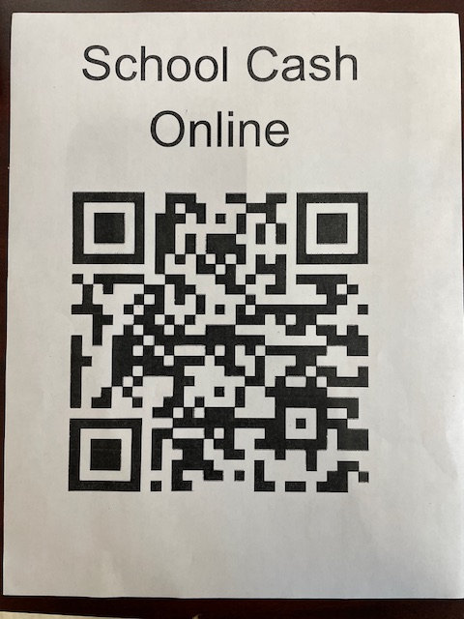
Your must use this link for any kind of money transaction at Richland

Slide 26


Slide 27


